Slide 1
Draw your own Stamp
Illustrator

Slide 2
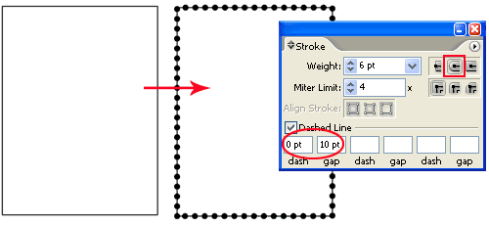
Begin by drawing a rectangle with your Rectangle Tool. Next copy the rectangle by pressing Ctrl/Command+C and duplicate 2 copies of the rectangle by pressing Ctrl/Command+F twice. Go to your Layers Palette and hide one of the rectangles as we will offset it later to create the inner edge of the stamp. Now, here’s the trick, we will need to create round dotted lines around the stamp. Open up you Stroke Palette and select the topmost rectangle. Copy the settings below. Make sure dash is kept at 0pt and gap is larger than the Weight. (Adjust your gap settings if you find the dotted lines overlap) Also select Round Caps for the Stroke as boxed in red.

Slide 3
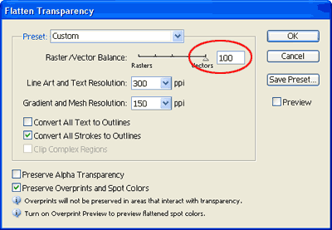
Now we will need to expand the dotted lines.Go Object>Flatten Transparency. Make sure it is set to 100% vector as shown below. Click ok when done.

Slide 4
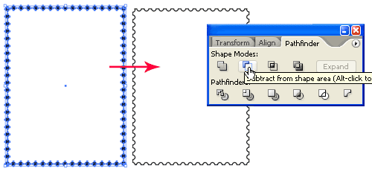
Select the expanded dotted lines and the rectangle below. Open up your Pathfinder Palette and hold Alt/Option and select Subtract from shape area. This will give you the sawtooth edges of a stamp.

Slide 5
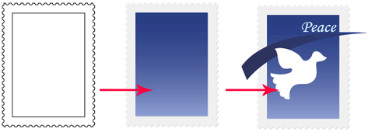
2. Drawing the stamp graphic
Go to you Layers Palette and show the hidden layer of our original rectangle. Go Object>Path>Offset Path. Enter a negative value. This will create the inner edge of our graphic area. Now I will start filling my stamp with different colors. Start drawing your own graphic- this time, try to draw a dove, and write the word “peace” using the text tool.

Slide 6
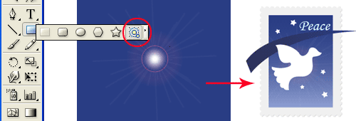
I have a star burst effect behind the dove. To create this effect go and select your Flare tool and draw a sun flare. I then hide it behind the dove.

Slide 7
4. Creating the mail stamp
Let’s move on to the final step of creating the mail stamp. Draw a circle using Circle Tool and holding Shift as you draw. Draw a smaller circle inside it. Next draw a line with the Line Segment Tool by holding Shift and drag. Select the Line and hold Alt/Option and drag down to duplicate a new line. After you have created 5 rows of lines, nudge the lines to the left so that it doesn’t overlap the circle.
Select the 5 rows of lines and go Effect>Distort & Transform>Zig Zag. Enter the values on the next slide and click Ok. Go Object>Expand Appearance after that.

Slide 8
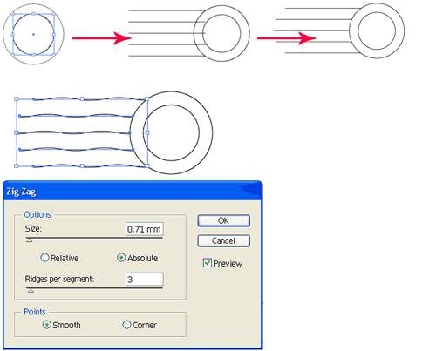

Slide 9
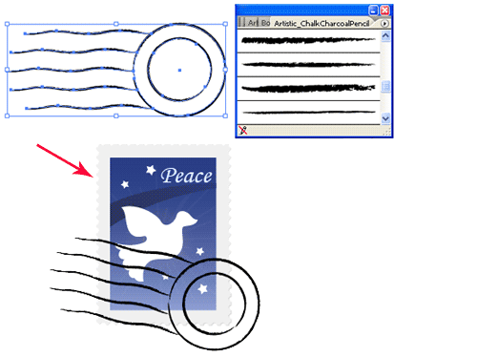
Open up your Brushes Palette (Window>Brushes). Click the arrow icon at the top right and choose Open Brush Library>Artistic_ChalkCharcoalPencil. Select your mail stamp and select a thin charcoal brush to give make it a textured line. Finally we will move our mail stamp over our stamp graphic and we are done.

Slide 10
Upload to Google Docs Activities, name it Dove Stamp. For the remainder of class, come up with your own unique stamp, that includes an image and text.

